Slide 1
The Arc of Virginia 2021 Virtual Convention Within our Power August 12, 2021
Head Start 101
Supporting Early Learning, Health,
and Family Well-being
DAwn Ault
Executive director
Virginia Head Start Association

Slide 2
KWL Chart about Head start
What you KNOW | What you WANT to know | What you LEARNED

Slide 3
While thinking of KWL, Enjoy Fatherhood engagement videos
Dad & son conversation, language development
Dad & daughter social-emotional connection with music & movement
Dad & son fun learning interaction, engaging
Lots to unpack here! Social-emotional connections, early childhood development. parent as first teacher, language development, cognition, physical movement to music, one-on-one interactions, laughter, love…. You name it!

Slide 4
Objectives
Participants will learn:
History and structure of Head Start
Understand federal to local funding
Eligibility, Recruitment, Selection, Enrollment, Attendance
School Readiness goals
Comprehensive services with two-generation approach
How to find a Head Start program in VA

Slide 5
Head start Overview
Federal Program
Comprehensive early childhood development services to low-income children and their families since 1965
Comprehensive services include educational, health, nutritional, and family services
Services intended to prepare children to enter kindergarten and to improve the conditions necessary for their success in later school and life
1994 – Creation of EHS, establishing services for pregnant women, infants and toddlers.

Slide 6
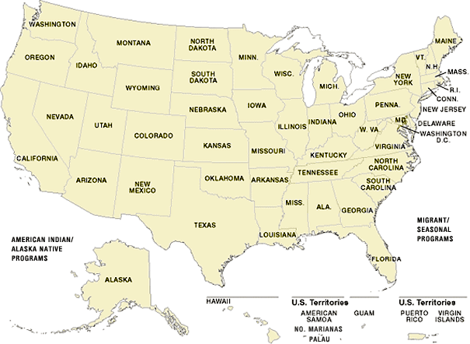
Head Start serves over a million children and their families each year in urban and rural areas in all 50 states, the District of Columbia, Puerto Rico and the U.S. territories, including American Indian, Alaskan Native and Migrant/Seasonal communities.

Slide 7
The 2 squares represent early childhood by suggesting building blocks.
The arrangement of the blocks represent stairs by which this can be accomplished.
The vertical stripes represent the child and parent.
The arrow pointing upward represents the direction out of poverty and on to the future.
The colors, red, white and blue represent the United States and the many opportunities it provides for its citizens.

Slide 8
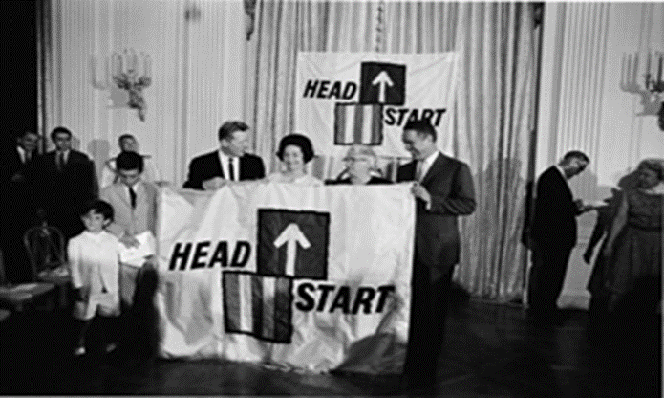
Head Start History
Summer program “Project Head Start” began in 1965 as part of the War on Poverty.
Head Start was designed to help break the cycle of poverty, providing preschool children of low-income families with a comprehensive program to meet their emotional, social, health, nutritional and psychological needs.

Slide 9
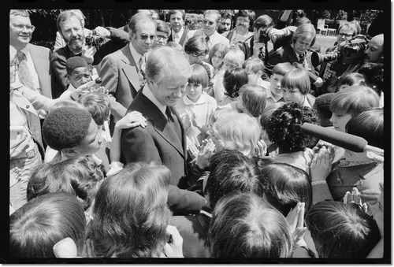
Head Start History
In 1977, under the Carter administration, Head Start began bilingual and bicultural programs in about 21 states.

Slide 10
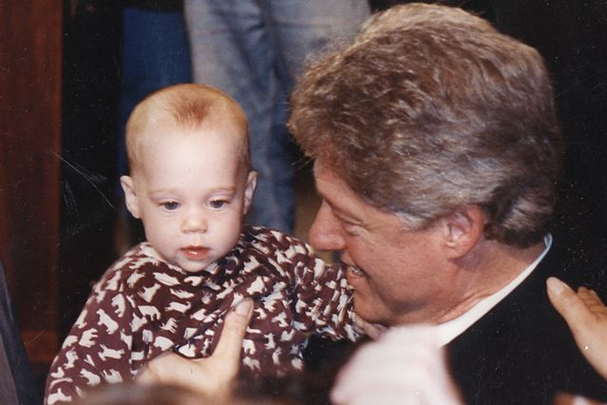
Head Start History
In1994, under the Clinton administration, the first Early Head Start grants were awarded.

Slide 11
Federal to local dollars
The Virginia network of organizations that administer HS and EHS programs include
community action agencies
non-profit agencies
school districts
Federal funds are granted to these community-based programs through the Office of Head Start (OHS), a division of the Administration for Children and Families within the U.S. Department of Health & Human Services.

Slide 12
What exactly is head Start?
Early Head Start and Head Start video - 3 minutes

Slide 13
ERSEA
ERSEA stands for the Eligibility, Recruitment, Selection, Enrollment, and Attendance of children in early childhood education programs
ERSEA governs how programs select and enroll children into their program and is one of the most important tasks to be performed in successful Head Start programs.

Slide 14
ERSEA
ERSEA governs how programs determine eligibility, enroll children, and track attendance. Discover resources to help programs assess the needs of their communities and recruit the children and families most in need.
https://eclkc.ohs.acf.hhs.gov/eligibility-ersea
The pandemic has caused a lot of changes to our enrollment.

Slide 15
School Readiness
School Readiness is a comprehensive term describing those capabilities of children, their families, schools and communities that best promote student success in kindergarten and the later grades.
“Ready Children” are prepared socially, personally, physically, and intellectually within a variety of domains (literacy, mathematics, science, history and social science, physical and motor development) and personal/social development.

Slide 16
disabilities
Early Head Start/Head Start serves children with disabilities. At least 10% of enrolled students must be children with a disability. Through Head Start, we are able to identify and provided needed early intervention services for many children.
Health, Hearing, Speech, and / or Vision impairment
Autism
Developmental delay
Learning disabilities
Emotional /behavioral disorder
Orthopedic impairment
Multiple disabilities

Slide 17
Health program services
A major hallmark of Head Start’s comprehensive services is the attention to the health and well-being of pregnant women and children enrolled in the program.
EHS/HS programs work with their community health resources to ensure that the children enrolled in the program are able to access a source of continuous, affordable health care, and obtain up-to-date immunizations and physical exams.
EHS/HS programs help enrolled children, secure continuous oral health care
EHS/HS programs help support mental health services for children and families

Slide 18
Parent and Family Engagement
Parent and Family Engagement in EHS/HS refers to building relationships with families that support family well-being, supporting strong relationships between parents and their children, and nurturing ongoing learning and development for both parents and children.
These goal-directed relationships are part of the two-generational approach of working with children and adult family members which distinguishes EHS/HS from other early childhood initiatives.

Slide 19
Examples of family support training
Emergency/crisis intervention such food, clothing, or shelter
Housing assistance such as subsidies, utilities, repairs, etc.
Mental health services
English as a Second Language (ESL) training
Adult education such as GED programs and college selection
Job training, career counseling
Substance abuse prevention and treatment
Child abuse and neglect services
Domestic violence services
Health education
Assistance to families of incarcerated individuals
Parenting Education
Relationship/marriage education
Asset building services (such as financial education, debt counseling)
Family assessment and goal setting

Slide 20
Families are powerful partners – engage them!
The Policy Council is a group of Head Start and Early Head Start parents and community members who help lead and make decisions about their program. Required 51% or more Head Start parents as composition of council.
Policy Council members are elected by the parents of children enrolled in the program. Parents often join the Policy Council after serving on a parent committee.
Members can serve for one year at a time, and for up to fve years. They work closely with the program’s management team and Governing Body to provide overall direction for the program.
Leading the Way video

Slide 21
Virginia head start Program locations

Slide 22
Virginia Head Start Association
The Virginia Head Start Association (VAHSA) is a not-for-profit 501(c)3 organization whose mission is to provide education, leadership and advocacy to support Head Start programs’ efforts in delivering high quality comprehensive services to Virginia’s children, families and communities.
https://www.headstartva.org

Slide 23
www.headstartva.org
For Families Tab: How to Register my Child?
For Families Tab: VA Head Start Program Locator
For Families Tab: Parent Ambassador Program
For Families Tab: Success Stories
Resources Tab: Fact Sheets

Slide 24
Questions? Comments?

Slide 25
KWL Chart about Head start
What you KNOW | What you WANT to know | What you LEARNED

Slide 26
While thinking of Head Start KWL, View this video
The head start race in life video – 4 minutes
Head Start Advantage – encourage you to search You Tube for this, 18 minutes

Slide 27
Virginia Head Start Association ww
Dawn Ault
Executive Director
dault@headstartva.org
Melissa Palombi
Communications & Events Manager
mpalombi @headstartva.org

